Slide 1
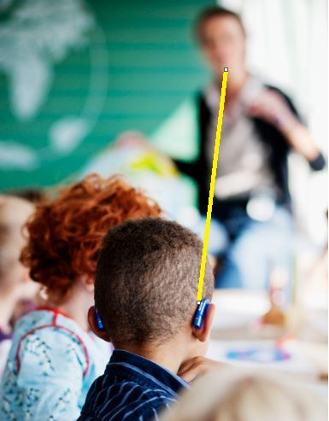
Your Student’s Hearing Assistive Technology
A quick and simple reference to using a Mini Mic

Slide 2
What is a Mini Mic?
An Mini Mic is a wireless system designed to help someone better identify and understand speech in noisy situations and over distances of up to 15 meters (50 feet). Some work together with hearing aids.
It transfers the speaker’s voice right into the hearing aids of your student.
The Mini Mic wirelessly connects to your student’s hearing aids using bluetooth technology.

Slide 3
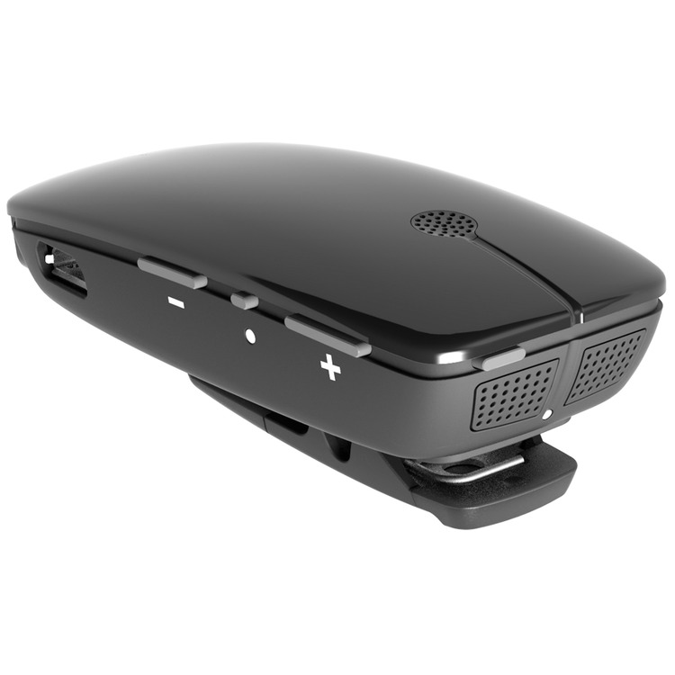
Parts of the Mini Mic
These dots are the microphone.
On/Off Button
Mute and unmute button

Slide 4
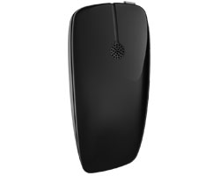
Front View of the Mini Mic

Slide 5
What do I need to know?
~Turning the system on and off with the “On/Off” button listed on the previous slide.
~Muting the system when you are not instructing or talking to the student.
~Unmuting the system when you are instructing of talking to the student.
~Connecting the system to other technology such as IPads, laptops or computers.

Slide 6
Tips for success
ALWAYS have the microphone holes uncovered and near your mouth
If you are wearing chunky necklaces, scarves, etc. make sure that they are not making noise that could be picked up by the microphone.

Slide 7
What happens if my student has a problem with their hearing assistive technology or hearing aids?
Email or call me!
In most cases, I will provide some suggestions for you to try. If equipment still isn’t working properly, I will plan to meet and take care of the issue within a day or two.
My contact information:
Phone: (412)-443-4338
Email: tmarquardt@northallegheny.org

